Slide 1
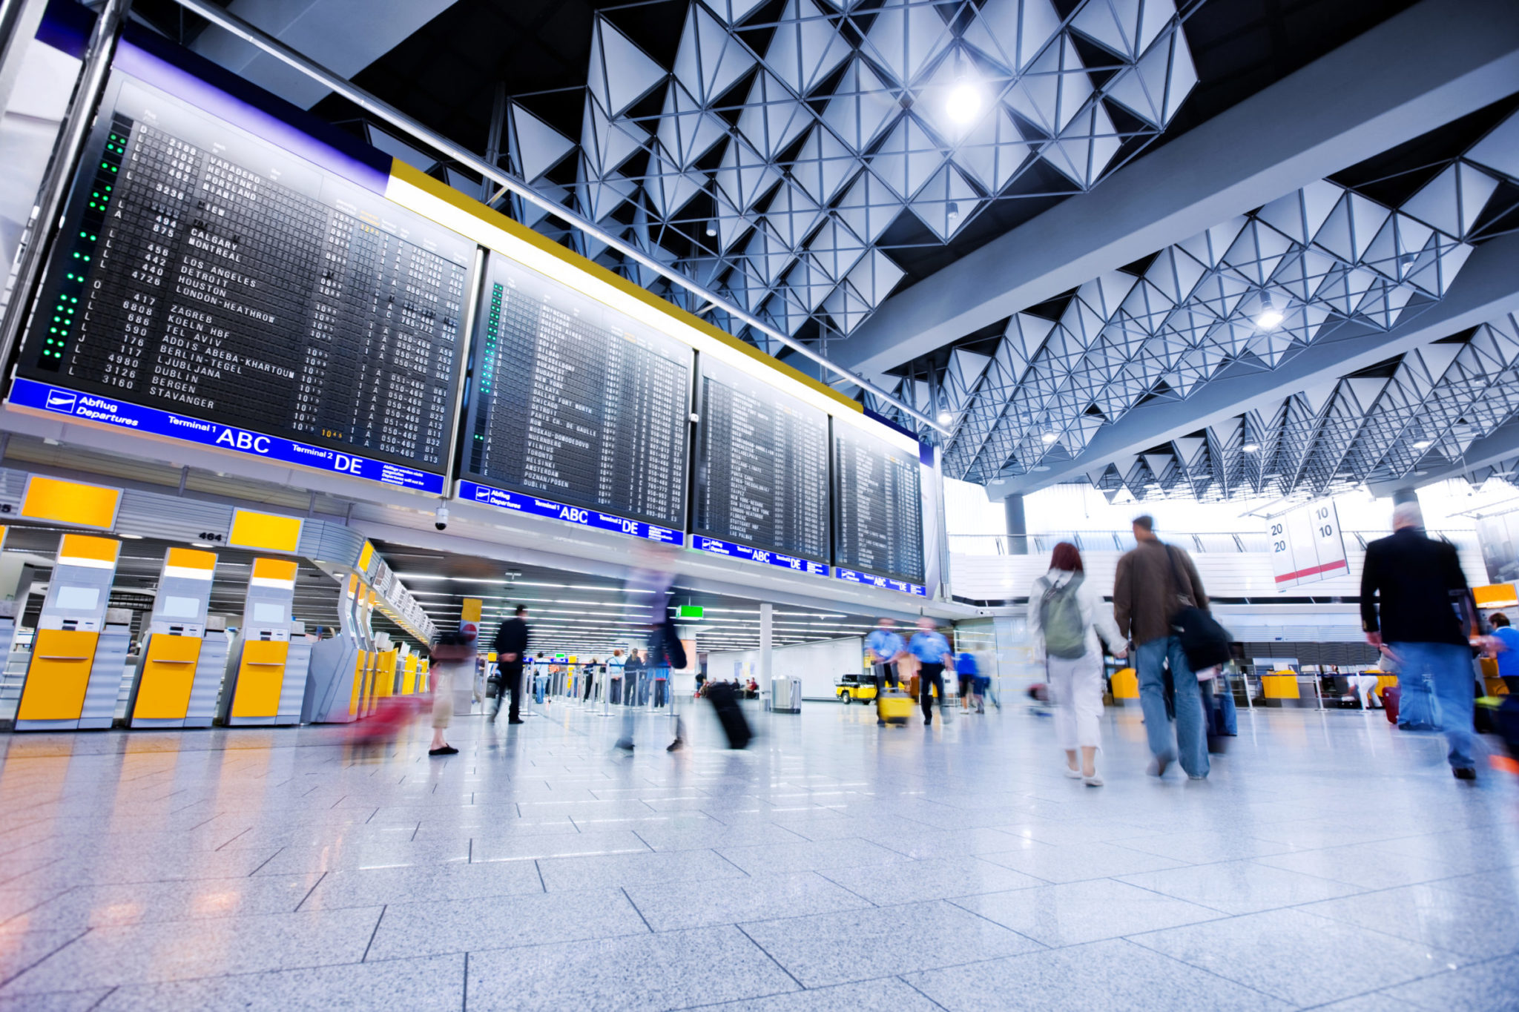
AIRPORT INFRASTRUCTURE GAP Submitted to: AIRPORT MANAGEMENT PROFESSIONAL ACCREDITED PROGRAM
Group 5
Azzan Ali Abdullah Al Jardani Geneva Turner John Italume
Marco Calvano Sharon Hislop-Holt

Slide 2
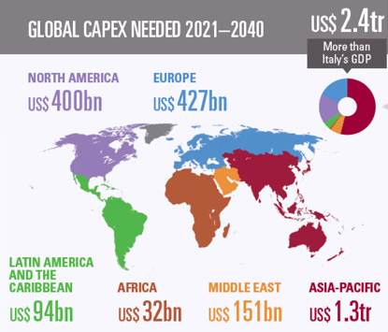
Airport Infrastructure Financing GAP - Overview
Global travel anticipated to grow at an annual rate of 4.5%
Infrastructure capacity constraints to meet growing passenger traffic and demands
Changes airline regulations will require changes to current airport infrastructure and facilities to meet new needs of airlines and for efficiency and improved service quality. Airports are economic engines of growth providing critical economic and social impacts for communities and countries, and facilitates trade, tourism and investments.
Airport Infrastructure Financing Gap of US$2.4t by 2040.
It is imperative that funding is available for sustainable development and improvements to airport infrastructure needs to meet future traffic demand and changes in requirement of passengers and airlines for continued economic benefits. Failure to meet the needed airport investment will result inability to serve aircraft due to lack of facilities which will impact traffic growth and risks future jobs and economic growth.
US airports funded mainly via the following sources”:
Airport Improvement Program (AIP grants
Passenger Facility Charges (PFC)– user fee
Bipartisan Infrastructure Law (BIL) grant
Airport-generated revenues

Slide 3
Challenges
Regulatory
Sustainability
Funding available for Investment give rise to Privatization
Increase in costs - fees and charges & Opportunities
Planning, Forecasting & Expanding non-aeronautical revenue

Slide 4

Regulatory Challenges – Lets discuss
The Airport is being governed by International regulatory standards although needs ratification by local Authorities however, these regulatory standards is to ensure uniformity in Airport management and operation. In terms of revenue generation, it is required that all revenue generated in the Airport must be Invested in the Airport. This is to ensure adequate financing and constant financial liquidity for the Airport. Some Airports are constraint to this as they may be unable to get external borrowings and funding. The government is unable to control the revenue generated by the Airport except collection of taxes.
This creates serious Financial gaps for the Airport as they may not be able to finance Infrastructures in the next future hence, they result to Service level agreements, concessions which tends to encourage long-term privatization.

Slide 5

Regulatory Challenges
Challenges
Recommendations
Limitation on AIP based on needs of all airports
Constraints placed on the PFC to passengers
Regulatory Burdens
Reporting Standards – Statutory Audits – ESG/ Sustainability - emerging
Regulatory Framework – ICAO policies – CORSIA
New Zero
Increasing AIP funding and expanding the program’s eligibility to terminals and other projects, along with flexible and light-handed economic oversight and adjustment to the federal cap on PFC user fees, would help airports to invest in facilities needed to accommodate rising customer volumes and expectations.
Airports face many unnecessary hurdles set by the federal government, from overregulation of airports resulting in delays in project approvals.
Government should relieve airports of unnecessary bureaucracy and provide more flexibility for more airline competition, lower fares, and an improved passenger experience.

Slide 6

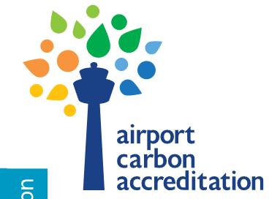
Sustainability Challenges
Challenges
Recommendations
Airports must work towards sustainable development by reducing the pollutants resulting from airport operation such as CO2 and the negative impacts of these on the Environment, Society and Economy.
ICAO policies on Climate Change - CORSIA, Net Zero, Airport Carbon Accreditation, Committee on Climate change in the UK limiting the flight operations to reduce carbon emissions.
Implementing CORSIA towards Net Zero Carbon emissions will require higher CAPEX investment; energy-efficient infrastructure and retrofitting; low emissions/electric vehicles and equipment;, renewable energy, investment in Negative Emissions Technologies (NETs)
Innovation to aircraft design for fuel efficiency will require additional CAPEX for gate size and configuration, currently in service. Airports will need to further invest in refueling and in recharging infrastructure, SAF,8 electric, hydrogen.
Green Capital funding required - public, private, and/or institutional investors
Innovative approaches, appropriate incentives, and flexibility in organizing and securing financing, such as green bonds or public-private partnerships
Development and access to renewal energy sources, reducing electricity through energy efficiency measures, improving access to green financing instruments, adapting airport infrastructure to serve alternative fuel aircraft, or fostering the development of negative emission technologies (NETs), governments to support and incentivize the sector to meet international sustainability goals.
Emissions Reduction Strategies

Slide 7
Environment Social Governance & Geopolitical Environment
ESG programs gives rise to:
Increase opportunities for funding – Companies with ESG commitment in better position to secure funding
Cost savings
Good reputation
Risk Management
Innovation & Resilience
Employee retention and commitment, low turnover
Enhanced Passenger Experience
Setting the rend for others
A company's performance is now measured based on their commitment to ESG by Investors, credit rating agencies and consumers.
Investors view companies with strong ESG program to perform better and are more stable while those without an ESG program bring environmental, legal and reputational risks. ESG measured in monetary figures to determine financial strength of company
Consumers are willing to pay more for products/services that address ESG issues

Slide 8
Investment Challenges & Recommendations
Challenges
Recommendations
Limitation on AIP based on needs of all airports
Constraints placed on the PFC to passengers
Regulatory Burdens
Limitations on:
Capital Funding
Grants
Sustainability Investment/Green Funding Options
User Fees - Increasing AIP funding and expanding the program’s eligibility to terminals and other projects, along with flexible and light-handed economic oversight and adjustment to the federal cap on PFC user fees, would help airports to invest in facilities needed to accommodate rising customer volumes and expectations.
Remove regulatory hurdles and overregulation of airports which result in delays in project approvals
Relieve airports of unnecessary bureaucracy and provide more flexibility for more airline competition, lower fares, and an improved passenger experience
Airports Self-Finance cost saving projects and re-invest in other areas
Debt Financing
Equity Financing
Notes:
Increase AIP funding, expanding AIP eligibility. AIP funding has
remained stagnant and, in most instances cannot be directed towards terminal projects despite these projects make up the vast majority of airports’ infrastructure needs.
Modernize the PFC, and reducing regulatory burdens. The PFC has been capped for more than 20 years with no adjustments for inflation. Therefore, airports’ primary funding mechanisms continue to lose purchasing power as inflation makes material, services, and labor costs increase while critical infrastructure needs continue to grow.
These would allow airports to use funds in a way that benefits them the best,
which in turn benefits the communities they serve.
Relieve airports of unnecessary bureaucracy to reduce regulatory burdens that delay critical infrastructure projects, and increase costs. Increasing the cap on the PFC, expanding the use of AIP funds to expand terminals, and providing more regulatory flexibility would result in more airline competition, lower fares, and an improved passenger experience.

Slide 9
Investment Challenges & Recommendations
Challenges
Recommendations
Capital intensive sector – mostly operated by Government
Explore options for ownership/operations & funding
Types of Models:
Government owned and privately operated (P3), Partially privatized airports (P3), Fully privatized airports
Management contracts, build-operate-transfer (BOT) models and trade sale/leases - IPO
Privatization continues to spread in the airport industry. Increase in investments and capital expenditures often follow privatization, indicating that privatization is a successful means by which to fund infrastructure development. Airports with private sector participation invested 14% more in capital expenditure measured as compared to their public counterparts and 12% more than the global average in the last five years.
Airport networks with private sector participation handle high levels of traffic.
Largest airport privatization in the Americas for 2022 was in Brazil, where Aena won the bid for Sao Paulo's Congonhas Airport, Brazil's busiest airport along with 10 smaller less profitable airports. This is now a trend in privatization, to bundle a profitable airport with smaller non-profitable ones.
Recommendations for policymakers and regulators considering privatization:
Clearly identify the objectives for their airports (from enabling infrastructure improvement investment to increasing connectivity) before choosing a privatization model.
Ensure that a clear and consistent legal framework is in place and adequate contract period
Consider the economic benefits and the privatization of group of airports/networks.
The choice of a privatization model must consider incentives for investors for a return to incentivize future investments in airport facilities and operations. They should be able to operate an airport as a business and generate returns on investment from both its aeronautical and commercial revenues. Applying dual or hybrid till regime induces cost efficiencies and innovations in the airport’s commercial business.
Foreign firms can bring access to large capital markets, potentially lower the overall cost of capital and expertise
Notes:
Increase AIP funding, expanding AIP eligibility. AIP funding has
remained stagnant and, in most instances cannot be directed towards terminal projects despite these projects make up the vast majority of airports’ infrastructure needs.
Modernize the PFC, and reducing regulatory burdens. The PFC has been capped for more than 20 years with no adjustments for inflation. Therefore, airports’ primary funding mechanisms continue to lose purchasing power as inflation makes material, services, and labor costs increase while critical infrastructure needs continue to grow.
These would allow airports to use funds in a way that benefits them the best,
which in turn benefits the communities they serve.
Relieve airports of unnecessary bureaucracy to reduce regulatory burdens that delay critical infrastructure projects, and increase costs. Increasing the cap on the PFC, expanding the use of AIP funds to expand terminals, and providing more regulatory flexibility would result in more airline competition, lower fares, and an improved passenger experience.

Slide 10
Increasing Costs as a Challenge – How Airports can Reducing costs
Costs in general increasing
Costs further increase with delays to airport infrastructure financing
Increased regulations on airlines to meet sustainability goals may impact airline ticket prices and possibly impact the ability of increasing PFC
While investment is a challenge, Airports can make some changes to result in efficiencies and cost savings to the airport
Competition from New modals – EVTOL
Technological Improvements & Digitization e.g. building insulation, energy efficiencies – smart building technologies biometrics,
Operational Improvements design of Runway/taxiway /innovation, Green building design
Renewable Energy sources - solar, wind, biomass, hydropower, use LED bulbs
Alternative Fuel sources - Sustainable fuel, Hydrogen
Waste Management – Reuse, recycle
Reduce usage – automatic switch off, rainwater harvesting,
Incorporating waste management targets into
contractual renewal/agreements with tenants
Collaborate with Energy other companies/private financing on a small scale Reinvested the savings into other areas.
Investment firms or Government provide incentives for sustainability - The Bipartisan Infrastructure Law provides $15 billion in airport infrastructure funding to be invested in runways, taxiways, safety and sustainability projects
Notes:
Costs in general are increasing and with delays to airport infrastructure financing, costs will increase further. In addition, with increased regulations on airlines to meet sustainability goals, the required changes will impact airline ticket prices and may impact the ability of increasing PFC as a means of revenue for airports.
With this in mind, while investment is a challenge, there are some changes that can result in efficiencies and cost savings to the airport, while at the same time are sustainable initiatives. There is also funding for these.
private financing on a small scale for smart projects as part of an overall airport infrastructure or digital master plan. projects like replacing terminal and airfield lighting with more energy efficient alternatives, provide a sustainable solution that uses less energy and therefore reduces operating costs. These savings can be reinvested in digital transformation-enabling elements like Wi-Fi, technology infrastructure and internet of things (IoT) sensors that, in turn, provide a springboard for improvements in operational efficiency, customer experience and sustainability as passenger demand grows along with the aviation industry.

Slide 11
Challenges to Planning, Forecasting & Expanding NAR
Changes in the airline industry and impact on airport operations, changes in the macro environment will make it harder the process of forecast traffic, financial projections, budget, strategic planning harder. Without the capital, hard to plan
Investment in Technology and digitization
Multifunctional modal system
Land use & Allocation
Review & update Master Plan every 5 years with changing environment
Amend Business/Financial Plan based on new/unplanned events to serve changing demands Expound
If done, this can reduce CAPEX for some passenger services now undertaken eg. may reduce terminal area required for baggage handling and check-in and seamless passenger journey and extended time in commercial area
Multifunctional modal system for efficient passenger flow mgmt. connecting landside and airside
Master planning important to include initiative that will impact or can benefit the airport eg. Ban on air travel in France that can be done on train
More airport land for other NAR with increased use of Technology and Sustainability – Some items moved off airport – Wind Turbine, Utilize airport lands for NAR especially where value added

Slide 12

Summary
Over the next decade, the top challenges airport industry will encounter includes regulatory, sustainability, funding available for investments given privatization, increase in fees, and expanding non-aeronautical revenue. It will be critical for airports to develop an adaptive master plan which addresses these challenges .
While adhering to regulations, airports may need to consider privatization which may provide more flexibility for funding in order to finance projects to expand/update their infrastructures to meet passenger expectations.
Airports will also need to develop strategies, which include leveraging technology for cost savings, efficiency and to increase non-aeronautical revenue and sustainability efforts, while closing the financial gap.

